Slide 1
Global Marketing
Management
A European Perspective
Market Selection &
Market Entry Alternatives
Warren J. Keegan
Bodo B. Schlegelmilch

Slide 2
Selecting Foreign Markets
... should be based on a number of criteria, for example
  market-related characteristics, such as product fit, market size and potential,
  cost-related aspects, such as transportation costs,
  the regulatory framework
  tariffs, duties and non-tariff trade barriers
the importance of these selection criteria depends upon the industry and the markets taken into account

Slide 3
Critical Questions for a
Product-Market Profile: The „9 W´s“
  1.Who buys our product?
  2.Who does not buy our product?
  3.What need or function does our product serve?
  4.What problem does our product solve?
  5.What are customers currently buying to satisfy the need and/or solve the problem for which our product is targeted?
  6.What price are they paying for the products they are currently buying?
  7.When is our product purchased?
  8.Where is our product purchased?
  9.Why is our product purchased?

Slide 4
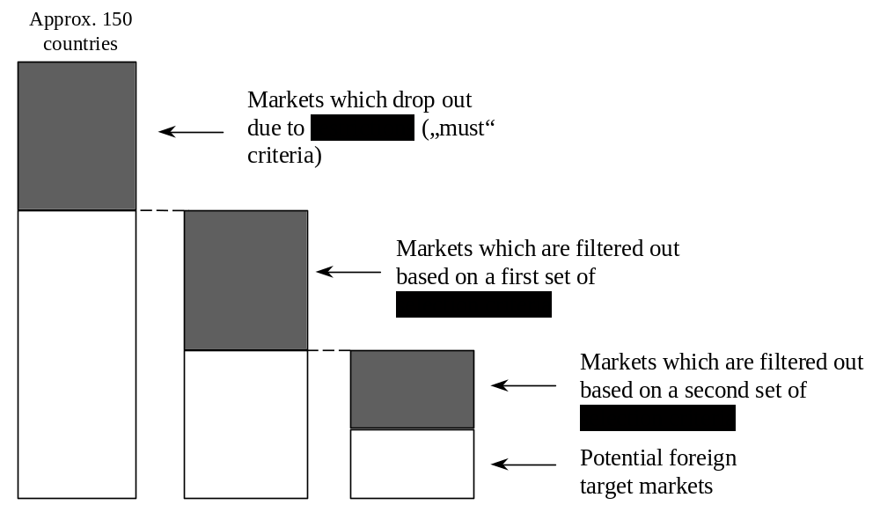
A Multi-Stage Selection Process
Source: adapted from D.J.G. Schneider, and R.U. Müller, Datenbankgestützte Marktselektion: Eine methodische Basis für Internationalisierungs-strategien, Stuttgart, 1989

Slide 5
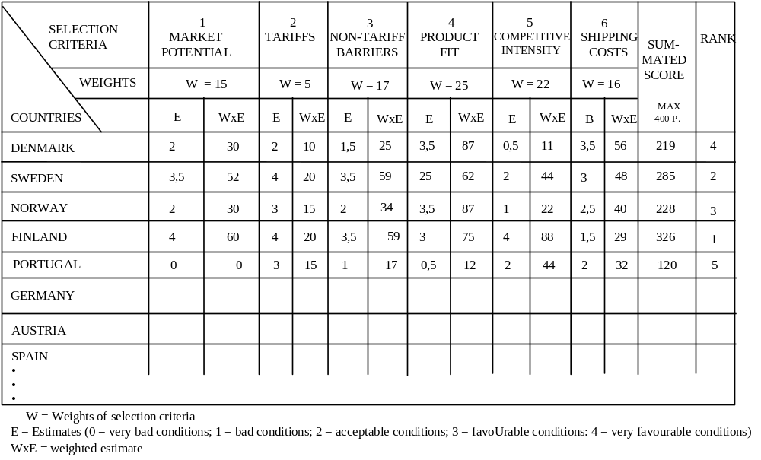
A Scoring Model for
International Market Selection

Slide 6
Visiting the Potential Market
... is essential after assessment and selection of potential market(s)
goals:
  to confirm (or contradict) assumptions regarding market potential
  to gather additional (primary) data; eg meeting potential distributors face to face
  to develop a marketing plan in co-operation with the local agent or distributor

Slide 7
Direct Exporting
Direct market representation
  via wholesalers or retailers or directly to the consumers
Independent representation
  independent distributor
Piggyback marketing
  distribution through another distributor´s channel

Slide 8
Exporting: A Developmental Process
The firm
1. ... is unwilling to export.
2. ... fills unsolicited export orders (export seller).
3. ... explores the feasibility of exporting (this stage may bypass stage 2).
4. ... exports to one or more markets on a trial basis.
5. ... is an experienced exporter to one or more markets.
6. ... pursues country or region focused marketing.
7. ... evaluates the global market potential. All markets, domestic and international, are regarded as equally worthy of consideration.

Slide 9
The „Born Globals“
= global start-ups = international new ventures
... do not follow the traditional developmental process
... are small firms which, at a very early stage of their business, already target international markets
... are innovative and take advantage of new technologies to excel in service to their customers
... in most cases achieve more than a quarter of their sales in foreign markets after 2 years in business

Slide 10
Export-Related Problems
Logistics
Legal procedure
Servicing exports
Sales promotion
Foreign market intelligence

Slide 11
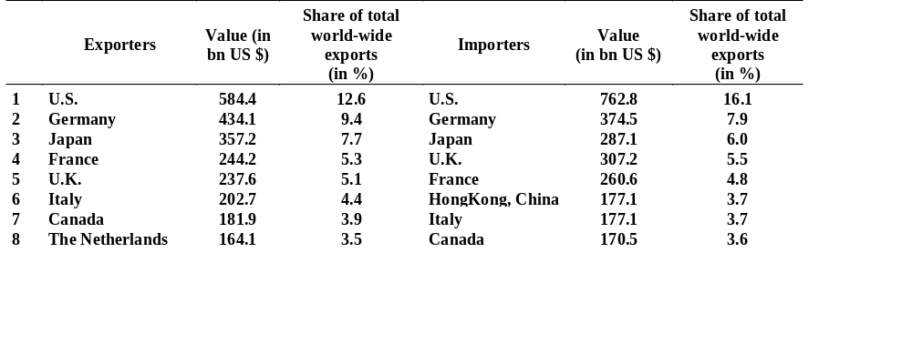
The World’s Leading
Exporting and Importing Nations
Source: „World Trade Growth Accelerated in 1997, Despite Turmoil in Some Asian Financial Markets“, World Trade Organisation 1998

Slide 12
Market Entry Decision:
3 Key Questions
1. How many resources and what investment are necessary to enter the market?
2. How much control of activities in the foreign market is desired?
3. How much market knowledge can the manufacturer gain by a specific market entry alternative?

